Slide 1
IT 140 Design Presentation Template Mario Game
Cheryl Buzicky

Slide 2
Storyboard: Description
The theme I chose for this game is Mario and Luigi’s Great Adventure. In this story, Mario and Luigi are on a mission to defeat the villain Bowser before destroys all the other worlds. To do this, they will need to collect special items from each of the other worlds they visit that will help them defeat Bowser once they encounter him in his castle. The fate of all the worlds will rest in the hands of two mediocre plumbers!
Each world is a place they will visit on their journey, and the brothers will need to collect all six items from these places before they encounter Bowser, or they will not be able to defeat him. The worlds include Mario and Luigi’s House in Brooklyn (starting point), Mushroom Kingdom, Princess Peach’s Castle, Snow Kingdom, Jungle Kingdom, Yoshi Island, the Dark Lands, and finally Bowser’s Castle. The items the brothers will need to collect are a banana to eat and help them get energy, a mushroom power-up to make Mario grow large to fight Bowser, a star power-up to make Mario faster, a freeze flower to help him freeze Bowser and disarm him, a Yoshi egg to hatch a Yoshi as a getaway ride, and turtle shell to throw at Bowser and knock him out. With these items in hand, the Mario brothers will be able to rid the universe of Bowser forever (or at least until the next movie comes out)!

Slide 3
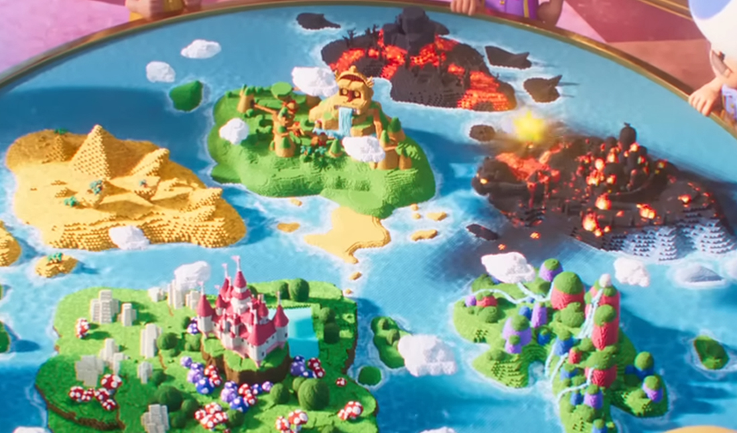
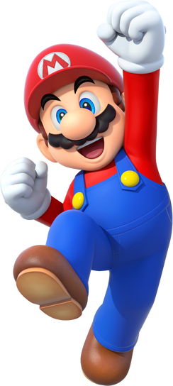
Storyboard: Map
Mario Worlds Map
Mushroom Kingdom
Item: mushroom power-up
East
Princess Peach’s Castle
Item: star power-up
West
North
South
Jungle Kingdom
Item: banana
Brooklyn
(Mario and Luigi’s House)
Snow Kingdom
Item: freeze flower
East
North
South
West
East
Yoshi Island
Item: yoshi egg
West
North
South
Dark Lands
Item: turtle shell
East
Villain: Bowser
Bowser’s Castle
West

Slide 4
Pseudocode: Move Between Rooms
START in Brooklyn (Mario and Luigi’s House), store as current_world
# Items will be called from dictionary of worlds, directions and items
INPUT: “Which direction would you like to move?”, store as user_direction
WHILE the current_world is equal to {Brooklyn}’:
IF user_direction is equal to “North”:
PRINT: “You have entered the {Mushroom Kingdom}.”
PRINT: “Item found: {Mushroom power-up}”
Change current_world to “Mushroom Kingdom”
INPUT: “Which direction would you like to move?”, store as user_direction
# This will repeat until the room with Bowser is reached.
ELIF user_direction is equal to “South”:
PRINT: “You have entered the {}.”
PRINT: “Item found: {}”
Change current_world to “ ”
# If the user enters a word that is not a direction
ELIF user_direction is not equal to a direction
PRINT: ”This entry is not valid. Please try again.”
# If the user enters a direction that does not take them to a world
ELIF user_direction does not end with a current_world
PRINT: ”Oops, wrong direction! Please try again.”
If all the items are collected before Bowser it reached, the player will win the game. If not, the player will lose the game and be prompted to play again.

Slide 5
Pseudocode: Get an Item
FUNCTION: This code is part of the function that will be labelled get_item_loop(get_item)
INPUT: user enters input to prompt “Collect Item?”, store as get_item.
WHILE the input is not equal to ”yes”:
IF user does not enter “yes” to get_item:
PRINT “Item not acquired! Try again.”
INPUT: user enters another input to prompt “Collect Item?”, store as get_item
IF user does enter “yes” to get_item:
PRINT: “Item acquired!”
ADD item to list ‘Inventory’

